Slide 1
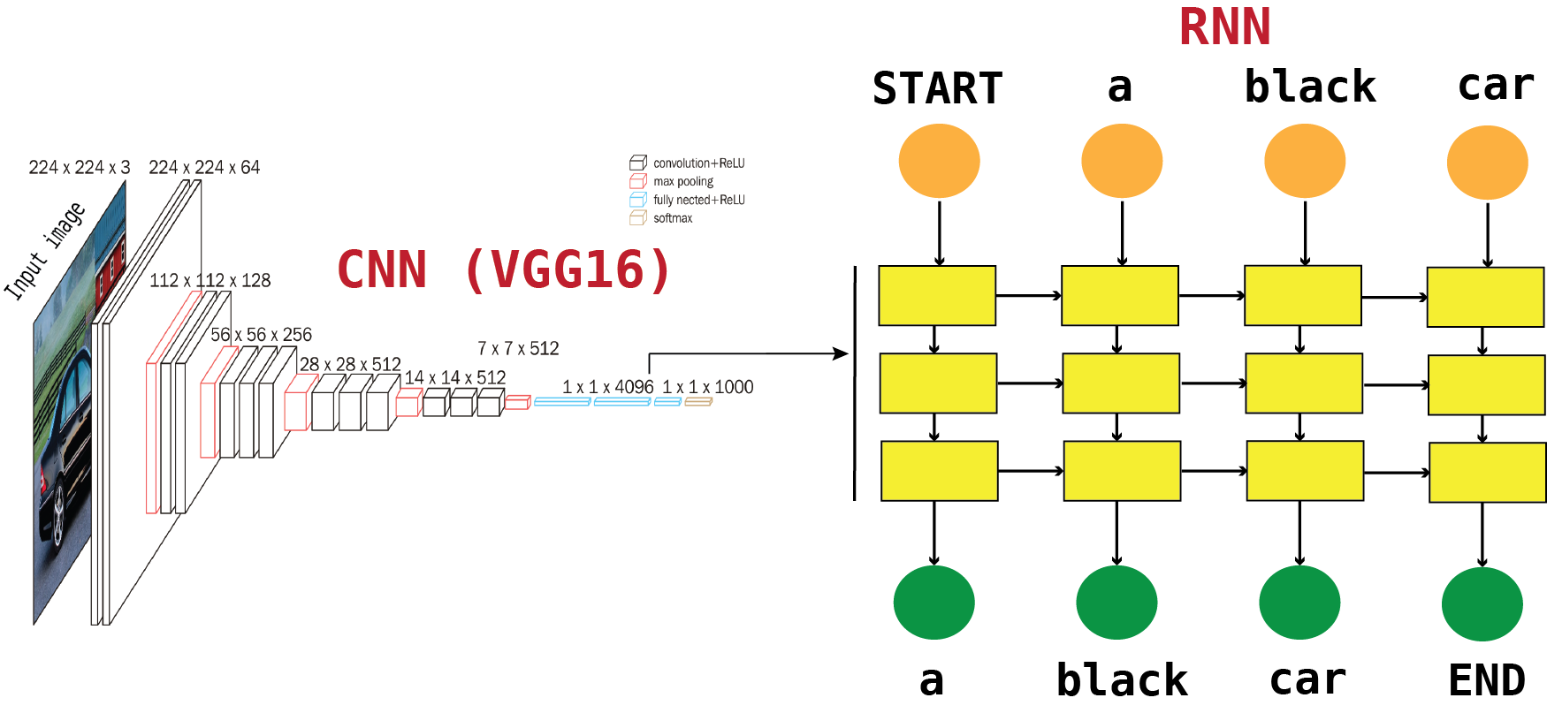
Multimodal Recurrent Neural Network (MRNN)
build model
process images
process captions

Slide 2
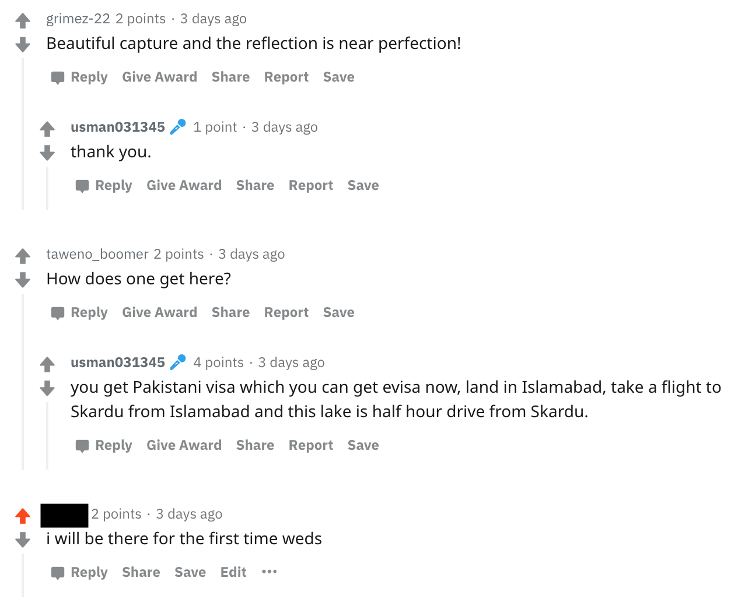
Perfect reflection in Upper Kachura lake, Baltistan, Pakistan. [OC] [3456x4608] Ig: Usman_zubair

Slide 3
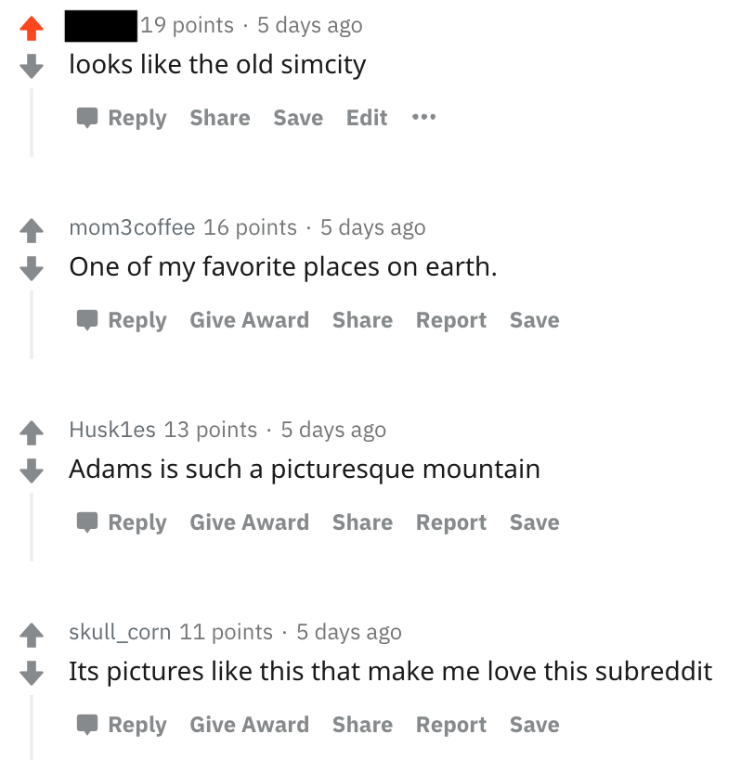
Towards Mt. Adams on the Pacific Crest Trail. Goat Rocks Wilderness, WA [OC][1600 x 1067]

Slide 4
Frequecy of the event
Number of total upvotes

